Slide 1

MegiMum
Pregnancy as a window to women's heart health:
AI-Powered digital cardiovascular care across the life course

Slide 2


Hypertensive disorders of pregnancy
10%
of pregnant women in the UK
16%
of maternal death globally
4X
long-term risk of hypertension
2X
long-term risk of heart attack and stroke
significant ethnic disparities
O'Kelly AC, Pregnancy and Reproductive Risk Factors for Cardiovascular Disease in Women. Circ Res. 2022 .

Slide 3
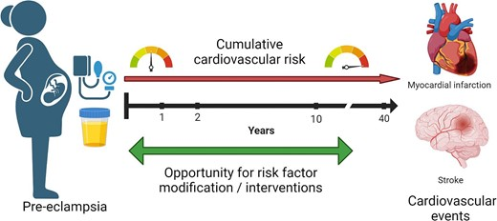

Pregnancy: A missed opportunity for screening and treatment
Conti-Ramsden F, Bramham K, de Marvao A. Commentary, European Heart Journal - Quality of care and clinical outcomes, 2024.

Slide 4
The clinical need: A recent MEGI focus group
“I had to go out of my way to make sure that I got postpartum care...my GP wasn't doing anything. My consultant...wasn't doing anything."
“Nobody believed in postpartum preeclampsia. And I had every symptom of it.”
Quotations from women with lived experience of pre-eclampsia, MEGI focus group January 2025 via Action on Pre-eclampsia charity.

Slide 5

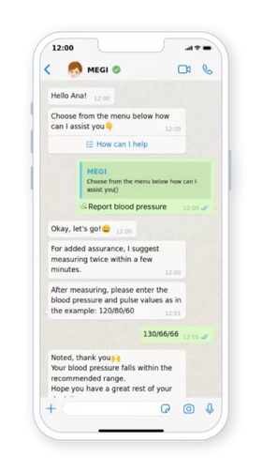
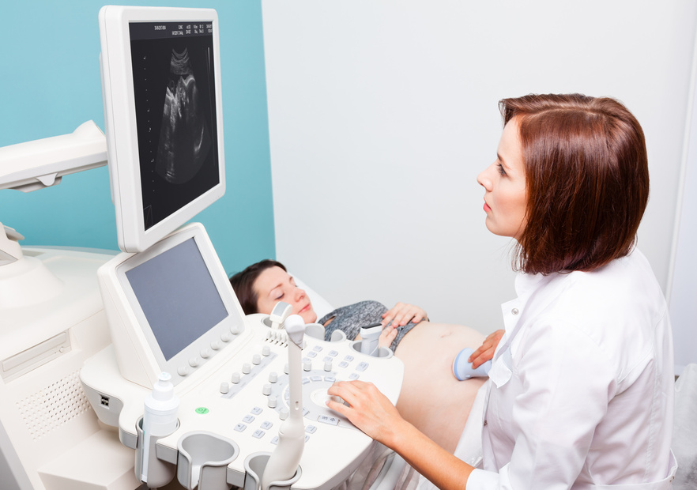

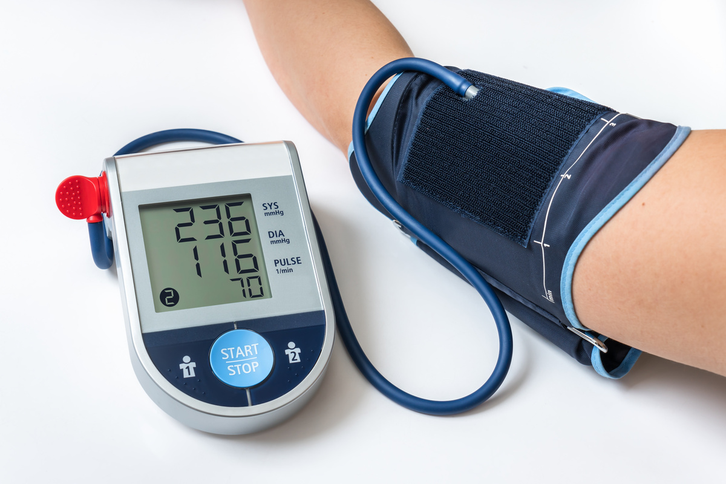


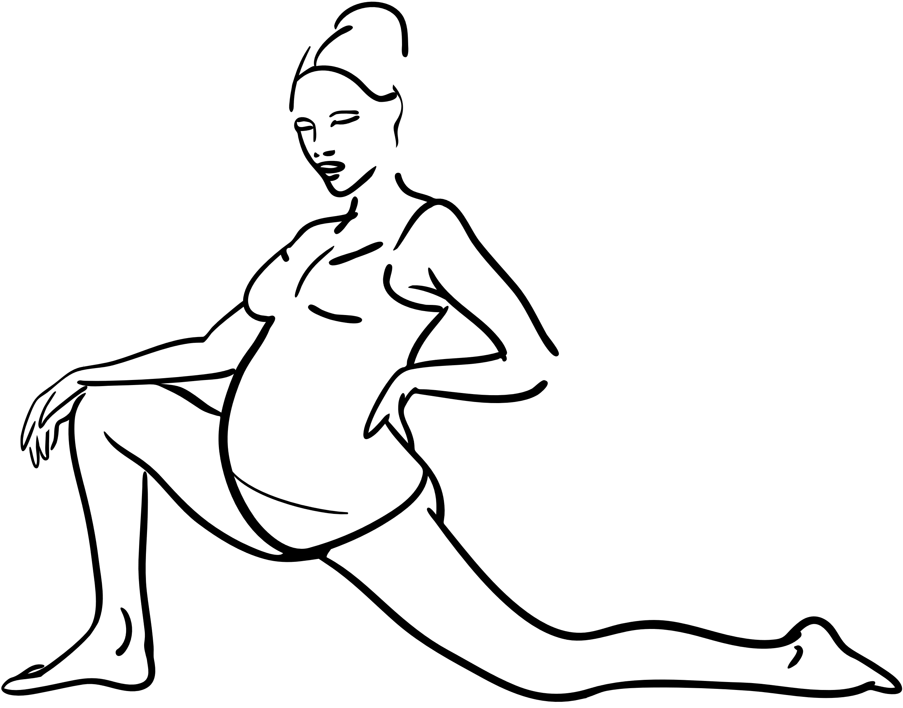
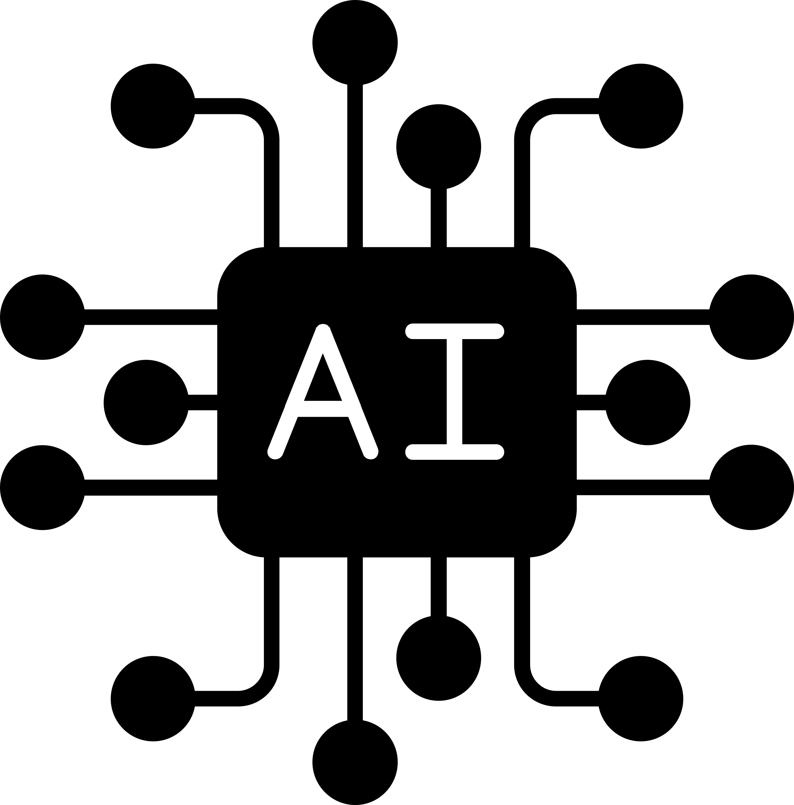



MEGIMum Empowers women to take control of their blood pressure for a safer pregnancy and optimisation of their long-term cardiovascular health
WOMEN
DOCTOR
Provides 24/7 education and support through seamless omnichannel communication.
Megi-Mum
Ensures women receives the right information, diagnosis and treatment, saving time for the care team and improving health outcomes.
serves as a bridge
Two-way smartphone communication facilitated by advanced large language models, collects patient data via text and camera.
Engages women and offers advice to self-manage their health, medictation and behaviour to manage hypertensive disorder of pregnancy (HDP)

Slide 6
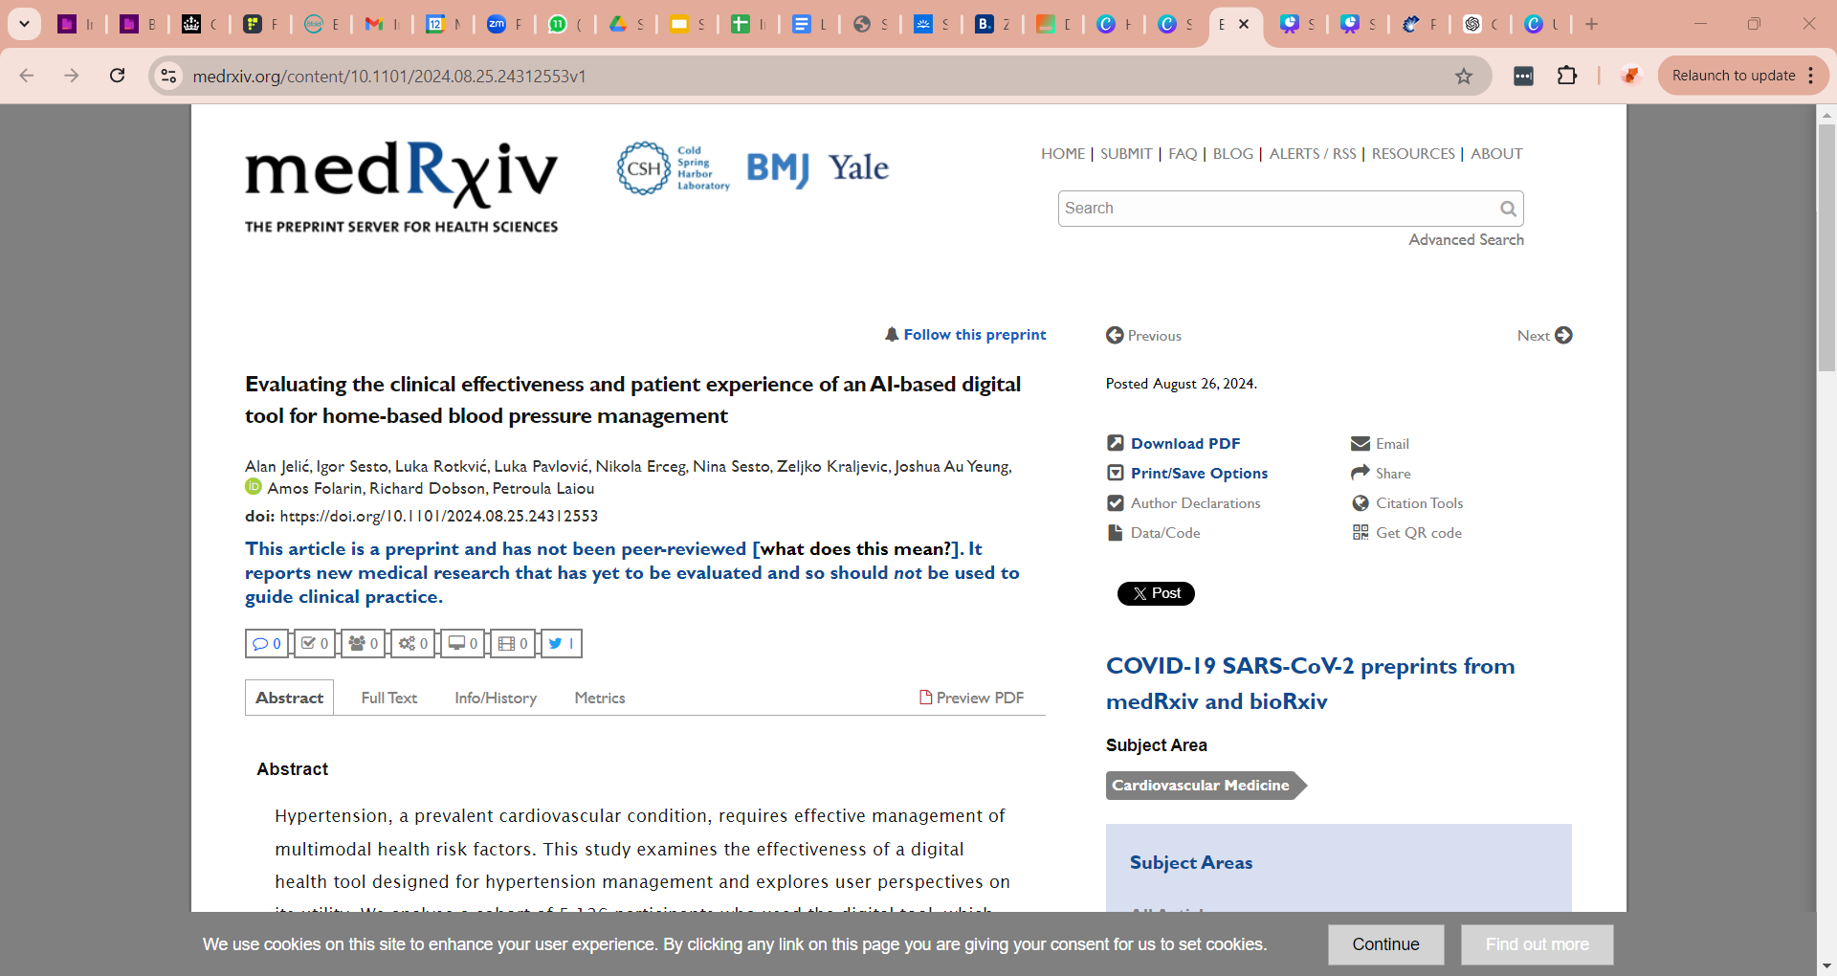
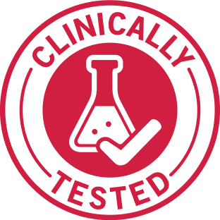
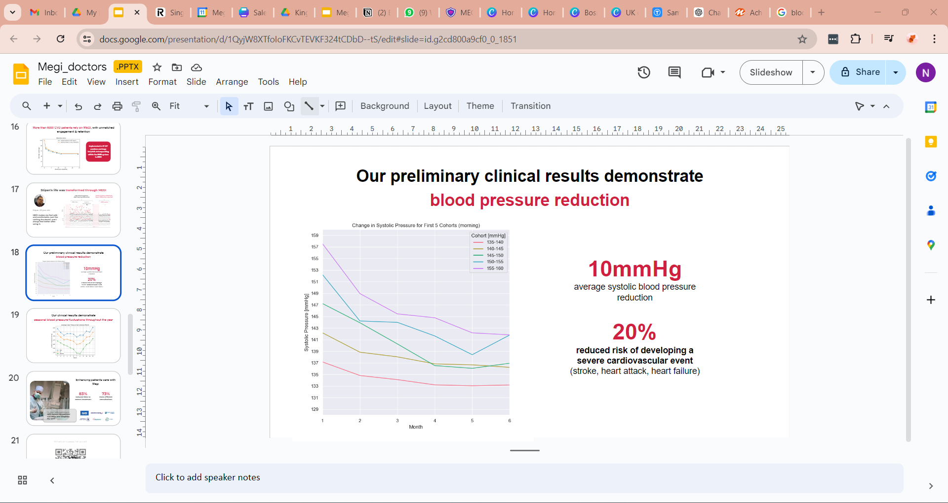
Existing Megi Health Platform
Clinically validated effectiveness on more than 8,000 patients.
EFFECTIVELY REDUCES BLOOD PRESSURE
by an average of 10 mmHg.
20% LOWER RISK OF HEART ATTACK AND STROKE

Slide 7
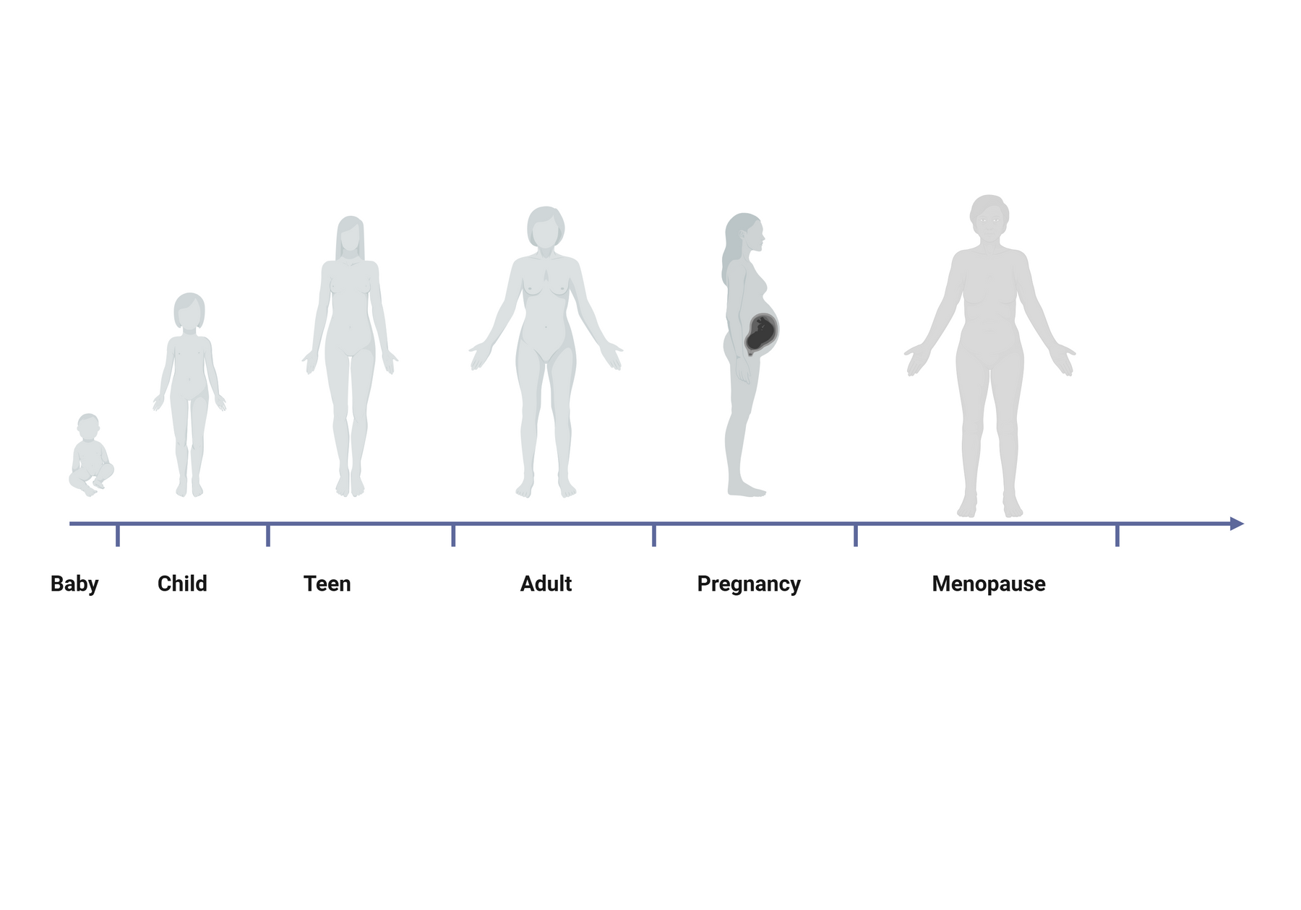
Postnatal research priority
Can clinician-overseen self-management of hypertension during pregnancy and the postpartum period leveraging the MEGI-Mum platform reduce progression to chronic hypertension and cardiovascular disease in women who have experienced a hypertensive disorder of pregnancy?
SCALABLE, ACCESSIBLE, PERSONALISED DIGITAL HEALTH SOLUTION
LIFECOURSE APPROACH

Slide 8
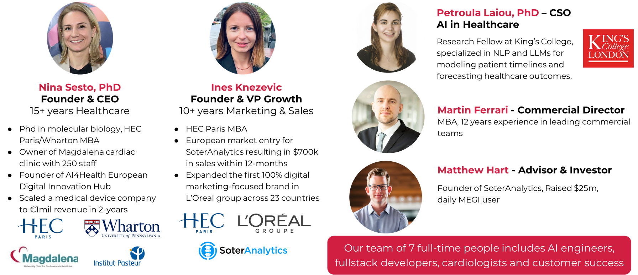






Thank you
Dr Frances Conti-Ramsden
Obstetrics & Gynaecology Registrar and Clinical Research Fellow. Her research interests are high-risk pregnancy, particularly Hypertensive disorders of pregnancy, and equity and inclusion in research.
Prof Richard Dobson,
Professor of Medical Bioinformatics, with research focus on machine learning and multimodality.
... and a team of 10, including AI experts, full stack developers, customer success, psychologists and UX.

